Slide 1
LinkBERT: Fine-tuning Pretrained Language Model with Document Links
Jyothesh Lagishetty
Chaithanya Kolli
Guna jaswanth reddy Maduri

Slide 2
Problem Deﬁnition & Previous Work
Goal of the paper is to demonstrate that incorporating document hyperlinks into the pretraining process by adding them to the context can improve language models by capturing the relationships between different parts of a document, ultimately leading to better performance on a range of downstream natural language processing tasks on Multi-hop QA.
Existing LM pretraining methods such as BERT typically consider text from a single document in each input context and do not model links between documents. This can pose limitations because documents often have rich dependencies (e.g. hyperlinks, references), and knowledge can span across documents.

Slide 3
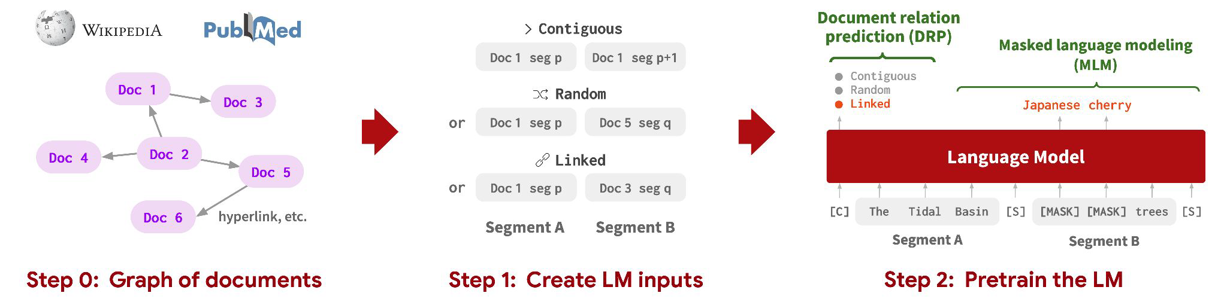
Main Idea
The LM is pretrained with two joint self-supervised objectives:
Masked Language Modeling : To learn concepts brought together in the context by document links
Document Relation Prediction : To learn relations between documents.
Take the Pretraining Corpus as graph of documents, G = (X , E), where E = {(X^{(i)} , X^{(j)} )} denotes link between documents.
For Document graph, directed edge (X^{(i)} ,X^{(j)}) if there is a hyperlink from document X^{(i)} to document X^{(j)}.
TF-IDF cosine similarity metric to obtain top-k documents X^{(j)} ’s and make edges (X^{(i)} ,X^{(j)} ).
Our modeling approach thus provides a natural fusion of language-based and graph-based self-supervised learning.

Slide 4
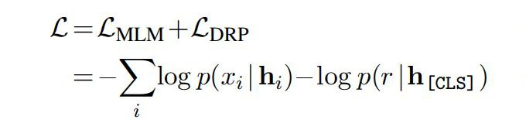
For input instances, sample an anchor text segment from the corpus (Segment A; X_{A}⊆X^{(i)} ). For the next segment (Segment B; X_{B}),
contiguous segment from the same document (X_{B} ⊆ X^{(i)}),
segment from a random document (X_{B} ⊆ X^{(j)} where j≠i), or
segment from one of the documents linked from Segment A (X_{B} ⊆ X^{(j)} where (X^{(i)},X^{(j)}) ∈ ε).
We then join the two segments via special tokens to form an input instance: [CLS] X_{A} [SEP] X_{B}
[SEP].
Document Relation Prediction (DPR), classiﬁes the relation r of segment X_{B} to segment X_{A}(r ∈
{contiguous,random,linked})
Loss Function:

Slide 5
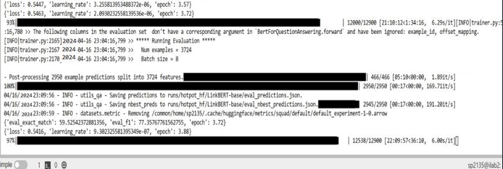
Results
Notably large gains on QA datasets that require reasoning with multiple documents, such as HotpotQA (+5% over BERT), TriviaQA (+6%).
LinkBERT is robust to distracting documents (-0.5%), While BERT incurs a large performance drop (-2.8%)
Model | HotpotQA
BERT | 73
LinkBERT | 78.2

Slide 6
Example of Better Performance
HotpotQA example
Question: Roden Brothers were taken over in 1953 by a group headquartered in which Canadian city?
Doc A: Roden Brothers was founded June 1, 1891 in Toronto, Ontario, Canada by Thomas and Frank Roden. In the 1910s the firm became known as Roden Bros. Ltd. and were later taken over by Henry Birks and Sons in 1953.... In 1974 Roden Bros. Ltd. published the book, "Rich Cut Glass" with Clock House Publications in Peterborough, Ontario, which was a reprint of the 1917 edition published by Roden Bros., Toronto.
Doc B: Birks Group (formerly Birks & Mayors) is a designer,
manufacturer and retailer of jewellery, timepieces, silverware and gifts, with stores and manufacturing facilities located in Canada and the United States. As of June 30, 2015, it operates stores under three different retail banners: ... The company is headquartered in Montreal, Quebec, with American corporate offices located in Tamarac, Florida.
LinkBERT predicts: "Montreal" (✔) BERT predicts: "Toronto" (X)

Slide 7
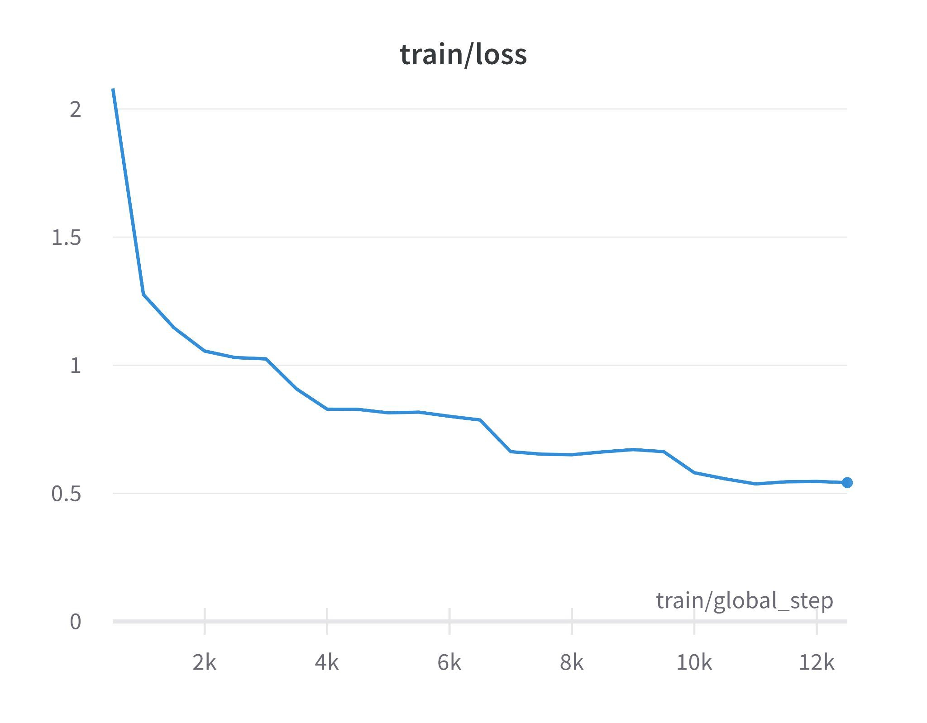
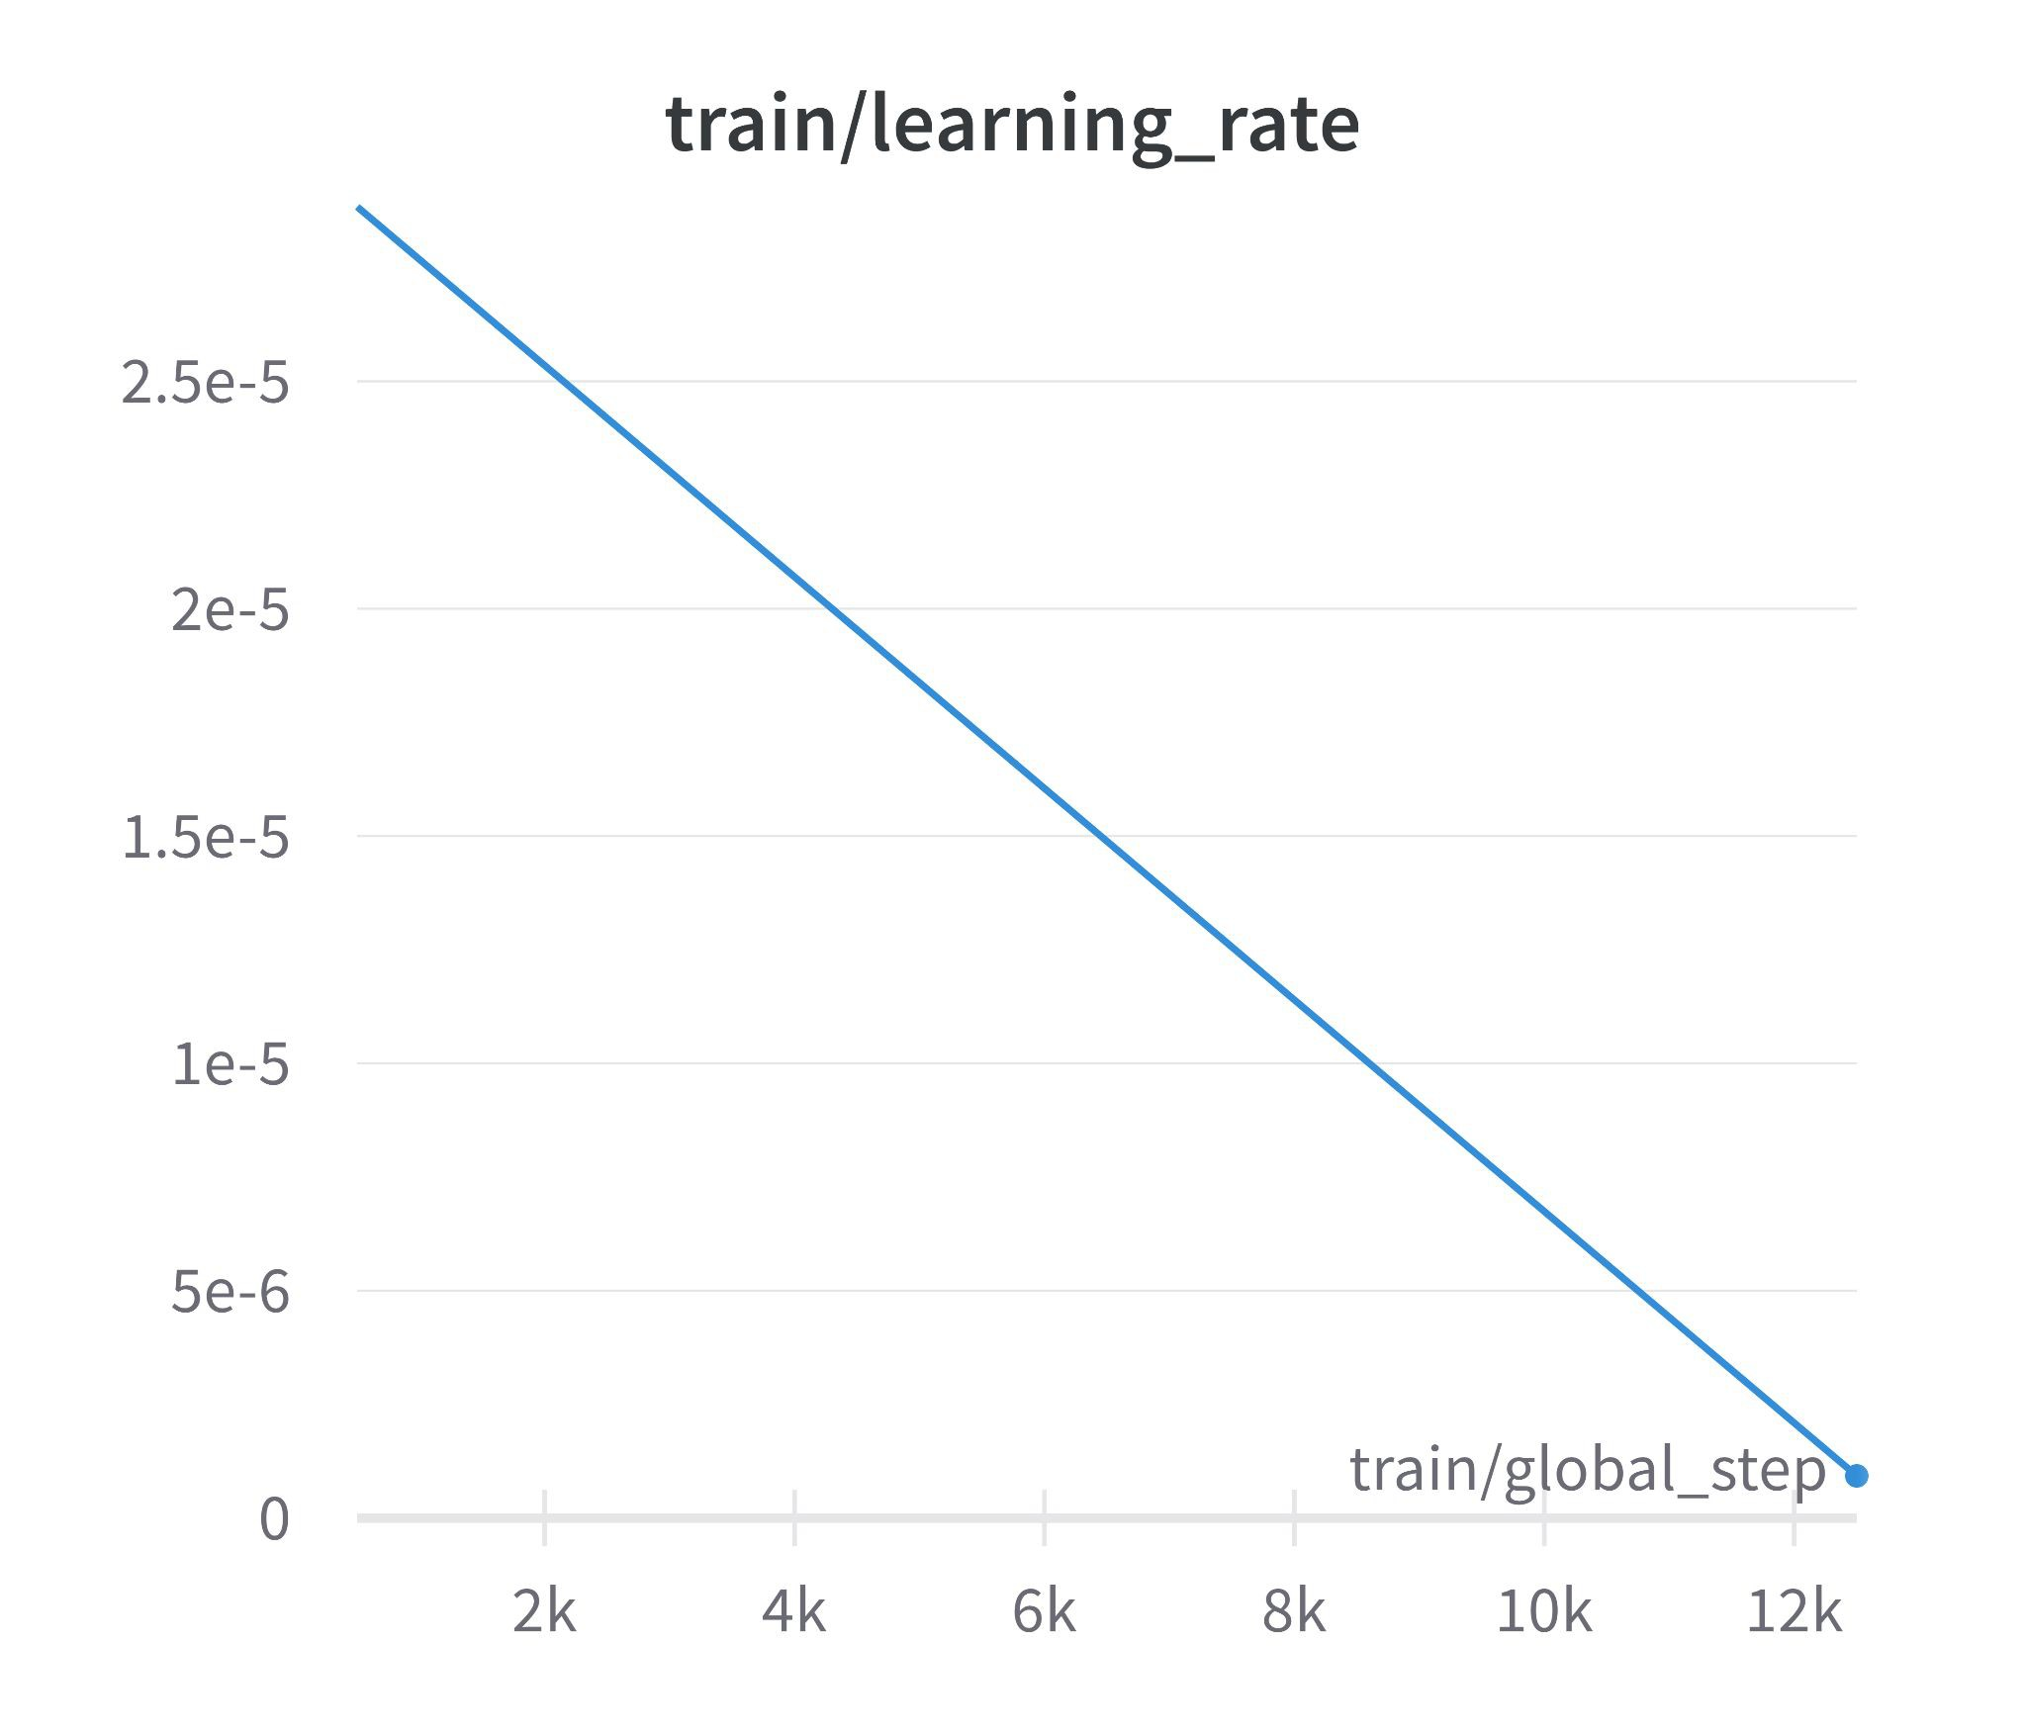
Evaluation Metrics

Slide 8
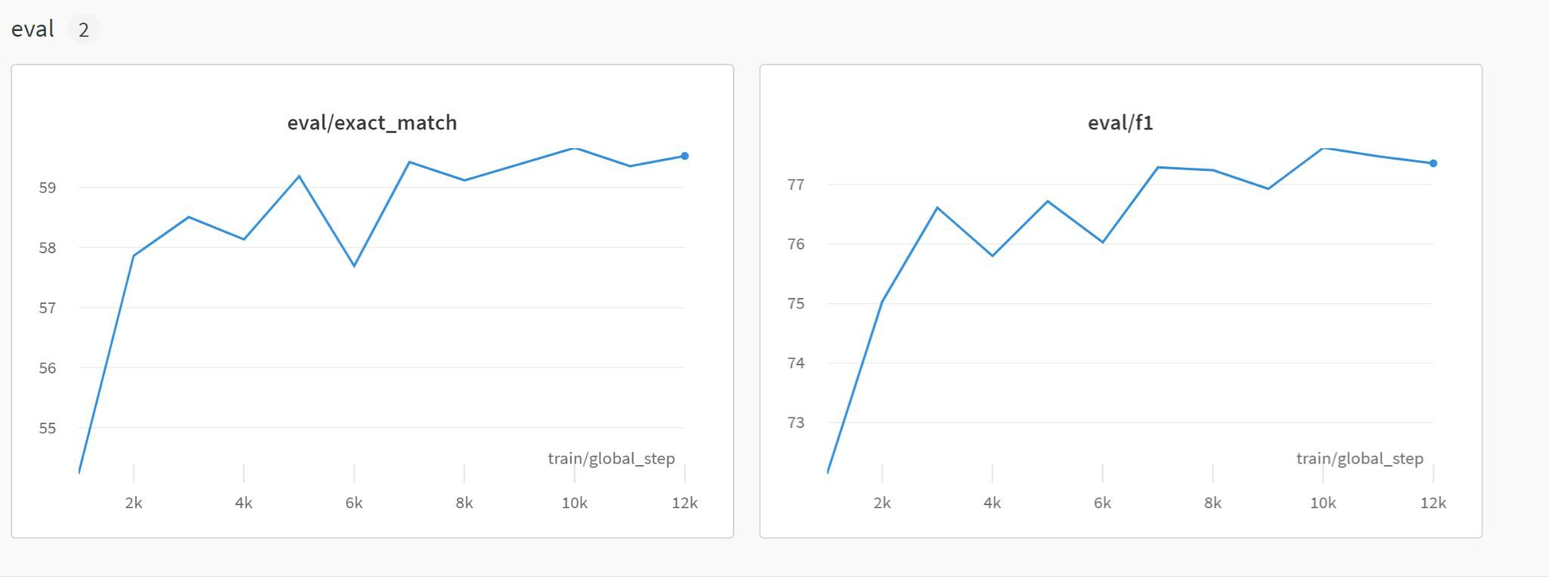

Slide 9
Thank you

